Slide 1
Skin Disease Detection Application

Slide 2
Our Team
Ahmed Khaled Moawed
Hazem Abd Elnasser
Mahmoud Saeed Mohamed
Mohamed Adel Fathy
Mohamed Abd Elhafez
Supervisor :
Dr . Rasha Ismail .
Supervisor Assistant :
Dr . Eman Bahget .

Slide 3
Contents
Introduction
Motivation
Problem Definition
Objectives
Related Works
System Architecture
Proposed Methodology
Demo
Future work
Conclusion
Software Tools
References

Slide 4
Introduction
Skin problem is growing fast all over the country .
It is one of the most common types of diseases where some can be painful, and some can cause fatal to human life .
We have to give attention towards this alarming health problem which is spreading fast to numerous reasons like pollution, global warming, ultraviolet rays, etc.
the cost of such diagnosis is still limited and very expensive

Slide 5
Motivation
1 - The last couple of years it has been harder to move around freely due to the coronavirus epidemic.
2 - skin diseases are chronic, infectious and sometimes may develop into skin cancer
3 - Our proposed approach is simple, fast and does not require expensive equipment's other than smart phone with a camera.
4 - To avoid delay in treatment, we have developed a model which will classify the disease using image dataset

Slide 6
Problem Defintion
1 - Skin disease is a very common problem across the globe.
2 – Seeing a Doctor Costs Money and Time
3 - There are many families who cannot afford this expensive examinations.
4 - It becomes very hard to identify sometimes as many disease resembles same symptoms.
5- Coronavirus Pandemic.

Slide 7
Objectives
Create lightweight Mobile application that helps in
identifying skin disease.
The application will have easy user friendly GUI.
Users would be able to use phone’s camera to take a
photo of their skin or upload an already taken photo
from there device.
The application would identify the disease.
The application would support many skin diseases.
Create accurate AI model to identify the disease .

Slide 8
Related Works
Medgic – Scan analyze and detect skin problems ( implemented by MEDNET PTE LTD ) .
Smart skin scanner

Slide 9
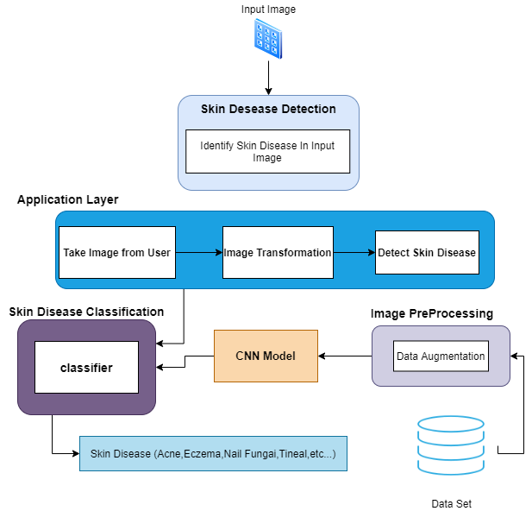
System Architecture

Slide 10
Proposed Methodology

Slide 11
Convolutional neural network CNN
Convolutional Neural Network, also known as CNN is a sub field of deep learning which is mostly used for analysis of visual imagery. This Neural Network uses the already supplied dataset to it for training purposes and predicts the possible future labels to be assigned.

Slide 12
Why CNN ?

Slide 13
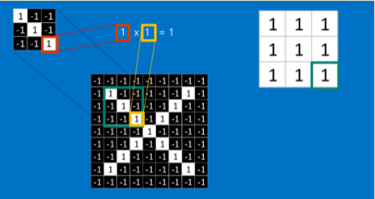
CNN’s layers 1 - Convolutional layer

Slide 14
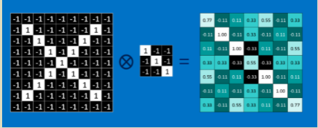
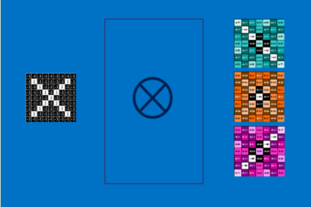
Feature maps

Slide 15
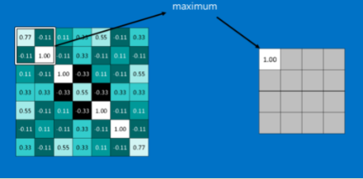
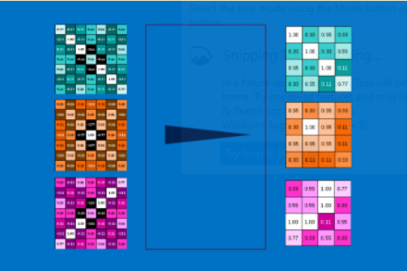
2- Pooling Layer

Slide 16
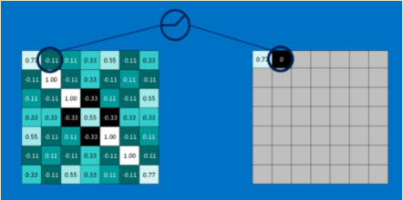
3- Rectified Linear Units RELU

Slide 17
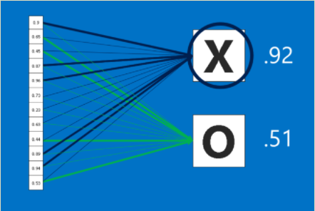
4-Fully Connected Layer

Slide 18
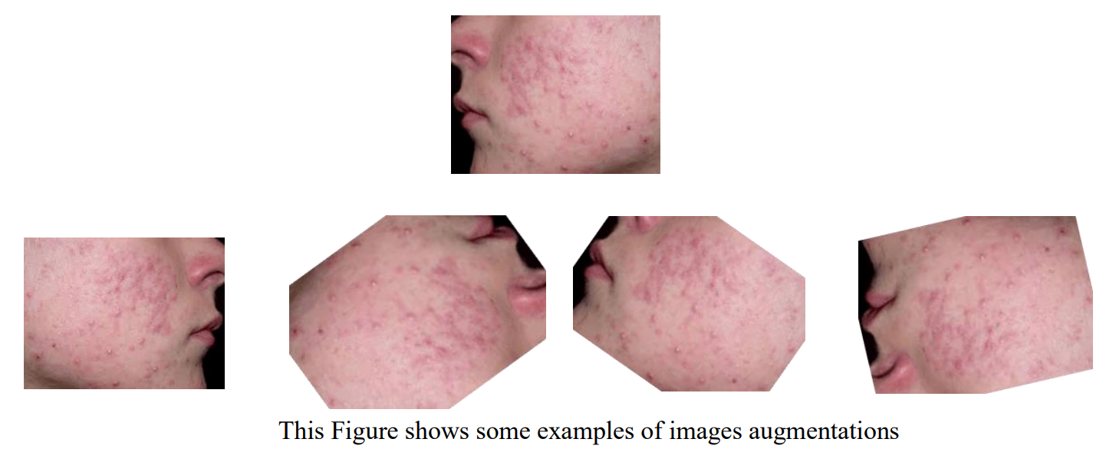
Data Augmentations
The prediction accuracy of the Supervised Deep Learning models is largely
reliant on the amount and the diversity of data available during training.
The relation between deep learning models and amount of training data
required is analogous to that of the relation between rocket engines (deep
learning models) and the huge amount of fuel (huge amounts of data)
required for the rocket to complete its mission (success of the deep
learning model).

Slide 19
Transfer Learning
Transfer learning is a machine learning technique where a model trained on one task is re-purposed on a second related task.
Transfer learning is an optimization that allows rapid progress or improved performance when modeling the second task.
Transfer learning is the improvement of learning in a new task through the transfer of knowledge from a related task that has already been learned.

Slide 20
Pre-Trained Model MobileNets
The MobileNet was proposed as a deep learning pretrained model .
This model is designed to effectively maximize accuracy while being mindful of the restricted resources for an on-device or embedded application.
MobileNets are small, low-latency, low-power models parameterized to meet the resource constraints of a variety of use cases. They can be built upon for classification, detection, embedding and segmentation similar to how other popular large scale models.

Slide 21

Demo

Slide 22
Conclusion
Our proposed system is based on a modern solution type of deep learning CNN that insure Performing the process as fast and as robust as possible. The basic techniques utilized in our proposed system include image dataset Augmentation, Convolution operations, features extraction, and finally classify the image based on skin diseases dataset. The experimental results demonstrate that the proposed method can Recognize skin diseases with accuracy reaches 87% and in a short time.

Slide 23
Future work
we will address the issue of large pretrained models that require large storage that can exceed 0.5GB ,
create an API and deploy the model on it so it can be while not affecting the mobile storage at all .
adding more diseases to our model to be identified.
increase the accuracy of the current model so that it can pass 95%.
More features will be added in the android application such as map services where the patients can locate nearby pharmacies or hospitals
Creating profile’s for patients and their medical records, this can help us in the future to identify specific diseases.

Slide 24
Software Tools
Python programming language
Keras deep learning framework
Anaconda distribution platform
Spyder integrated development environment
Android studio
Java programming language
TensorFlow lite framework

Slide 25
References
Arifin, S., Kibria, G., Firoze, A., Amini, A., & Yan, H. (2012) “Dermatological Disease Diagnosis Using Color-Skin Images.” Xian: International Conference on Machine Learning and Cybernetics.
Yasir, R., Rahman, A., & Ahmed, N. (2014) “Dermatological Disease Detection using Image Processing and Artificial Neural Network. “Dhaka: International Conference on Electrical and Computer Engineering.
Santy, A., & Joseph, R. (2015) “Segmentation Methods for Computer Aided Melanoma Detection.” Global Conference on Communication Technologies.
Zeljkovic, V., Druzgalski, C., Bojic-Minic, S., Tameze, C., & Mayorga, P. (2015) “ Supplemental Melanoma Diagnosis for Darker Skin Complexion Gradients.” Pan American Health Care Exchanges
Suganya R. (2016) “An Automated Computer Aided Diagnosis of Skin Lesions Detection and Classification for Dermoscopy Images.” International Conference on Recent Trends in Information Technology.
Alam, N., Munia, T., Tavakolian, K., Vasefi, V., MacKinnon, N., & Fazel-Rezai, R. (2016) “Automatic Detection and Severity Measurement of Eczema Using Image Processing.” IEEE.
Kumar, V., Kumar, S., & Saboo, V. (2016) “Dermatological Disease Detection Using Image Processing and Machine Learning.” IEEE.
Krizhevsky, A., ILYA, S., & Geoffrey, E. (2012) “ImageNet Classification with Deep Convolutional Neural Networks.” Advances in Neural Information Processing Systems.
Cristianini, N., Shawe, J., “Support Vector Machines”, 2000.
SOMMERVILLE, I., “Software Engineering”. 9th .2011.
M. Abadi, A. Agarwal, P. Barham, E. Brevdo, Z. Chen, C. Citro, G. S. Corrado, A. Davis, J. Dean, M. Devin, et al. Tensorflow: Large-scale machine learning on heterogeneous systems, 2015. Software available from tensorflow. org, 1, 2015

Slide 26
Thanks

